Slide 1
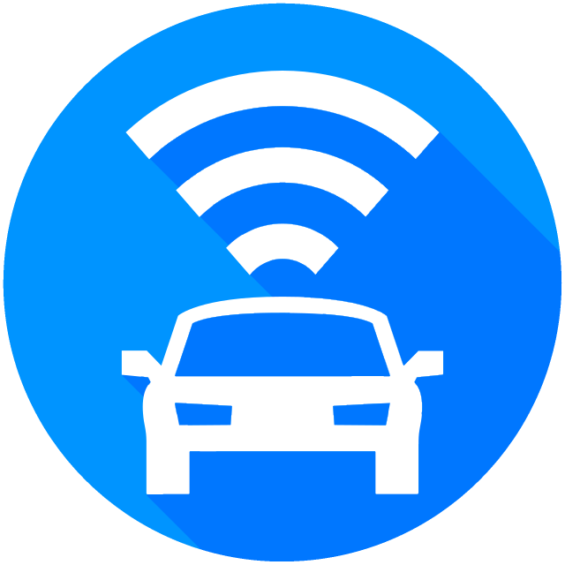
Smart AVL (Automatic Vehicle Locator)
ECE 492 - Group 9 Nicholas Hoskins Riley Dixon Adrian Schuldhaus
2019.04.11

Slide 2
The Problem
Notes:
So first we’re going to discuss a little bit of the motivation for this project.

Slide 3
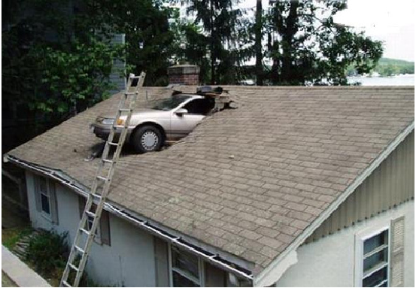
The Problem
Companies own a lot of vehicles (a “fleet”)
With many vehicles come many responsibilities
Vehicle maintenance
Ensuring safety
Logistics and efficiency
etc.
We need a way to gather data about each vehicle in our fleet!
Notes:
Some companies, particularly larger ones, own a lot of vehicles. This is particularly true if their business actually involves vehicles; for instance, if they’re a shipping or logistics company. The group of vehicles that a company owns is referred to as a “fleet” of vehicles, and the larger a company’s fleet becomes, the more problems they’ll face.
Foremost among these problems is vehicle maintenance - if your company have 500 cars, how can you be sure that they are all safe to drive? And even if the vehicle itself is safe to drive, how can you ensure that it’s being driven safely? And how can you optimize the routes of the vehicles? These are just some of the challenges that are faced by companies that have to maintain fleets.
One way to find answers to all these questions is by having some way of gathering data about the vehicles in our fleet. In particular, we really want to be able to gather data from our vehicles remotely, in real time. The “real time” part is important, since car crashes can happen in a split second. If you’re a company with a fleet, you really want to avert *this.* (show car crash picture that is on this slide)

Slide 4
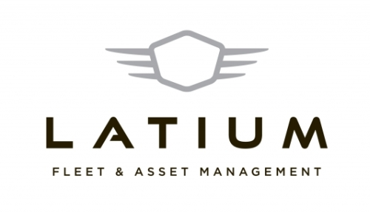
The Client
Notes:
There’s actually a company based in Edmonton that is dedicated to helping companies acquire and maintain fleets of vehicles. It is called Latium Fleet Management, and they offer a number of services to companies who want to be able to manage their fleets of vehicles more effectively. One of the main methods they use to accomplish this goal is by offering remote monitoring systems that are installed on fleet vehicles. This kind of system is what they were looking for in our capstone project, since it’s an effective solution to the problem that we laid out previously.

Slide 5
Our Solution
Notes:
Now that we’ve explained the motivation of the project, we will take a look at what our solution is.

Slide 6
Our Solution
Some factors to consider:
Should be able to operate under harsh weather conditions
Should be able to transmit data to remote users
Should be relatively small
Should support the possibility of future expansion
Notes:
When designing a device to perform the function of remote vehicle monitoring, we have a number of considerations to keep in mind.

Slide 7
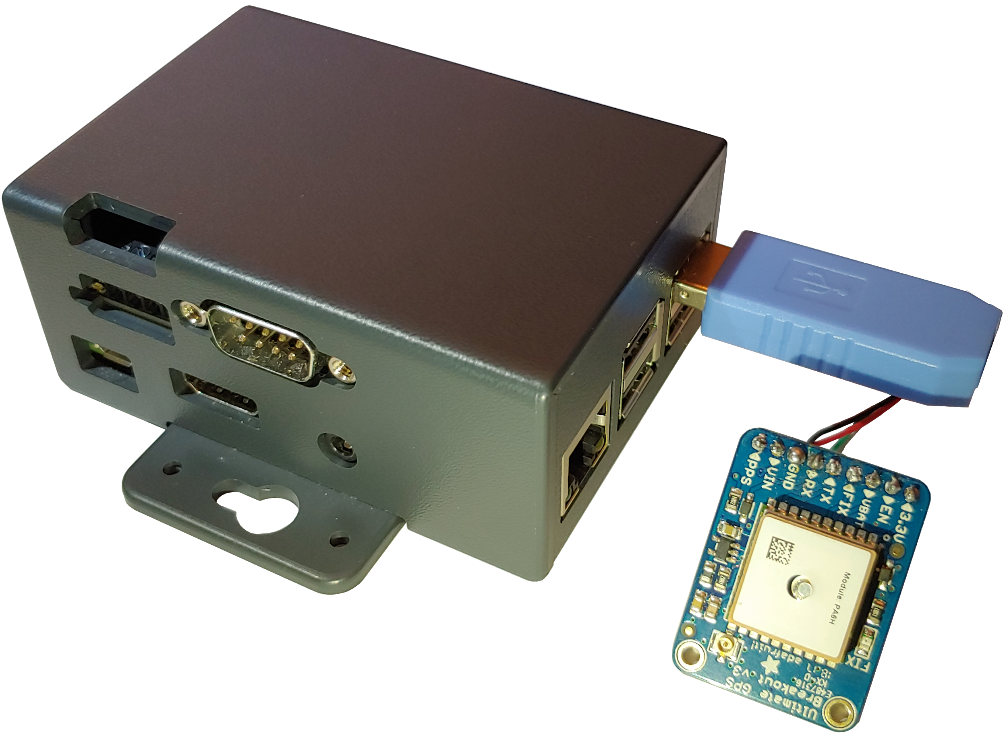
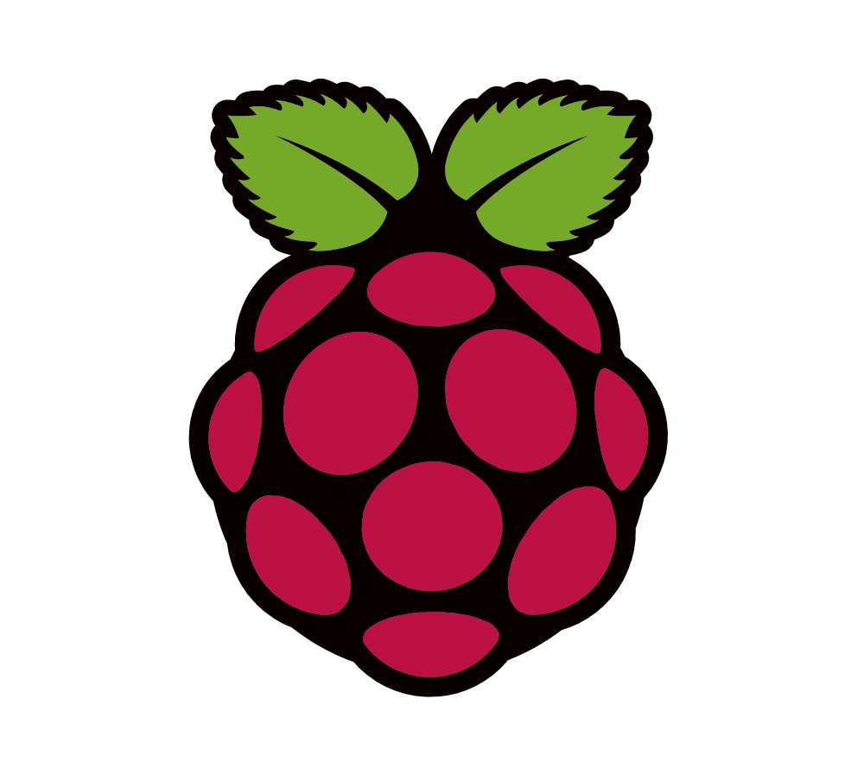
Our Solution
Smart AVL Device
Notes:
With all these considerations in mind, we chose the Raspberry Pi 3 B+ as the basis of our project. Not only is the Raspberry Pi very durable in extreme weather conditions, (rated to work down to temperatures of -40 degrees), but it is also relatively small, and supports the possibility for future expansion with its many extra GPIO pins and USB ports. The platform provides onboard wifi and Bluetooth capabilities, the latter of which we take advantage of in our project. Additionally, the documentation for the Raspberry Pi and the related libraries are very thorough, which we believe greatly facilitates the development of the project.

Slide 8
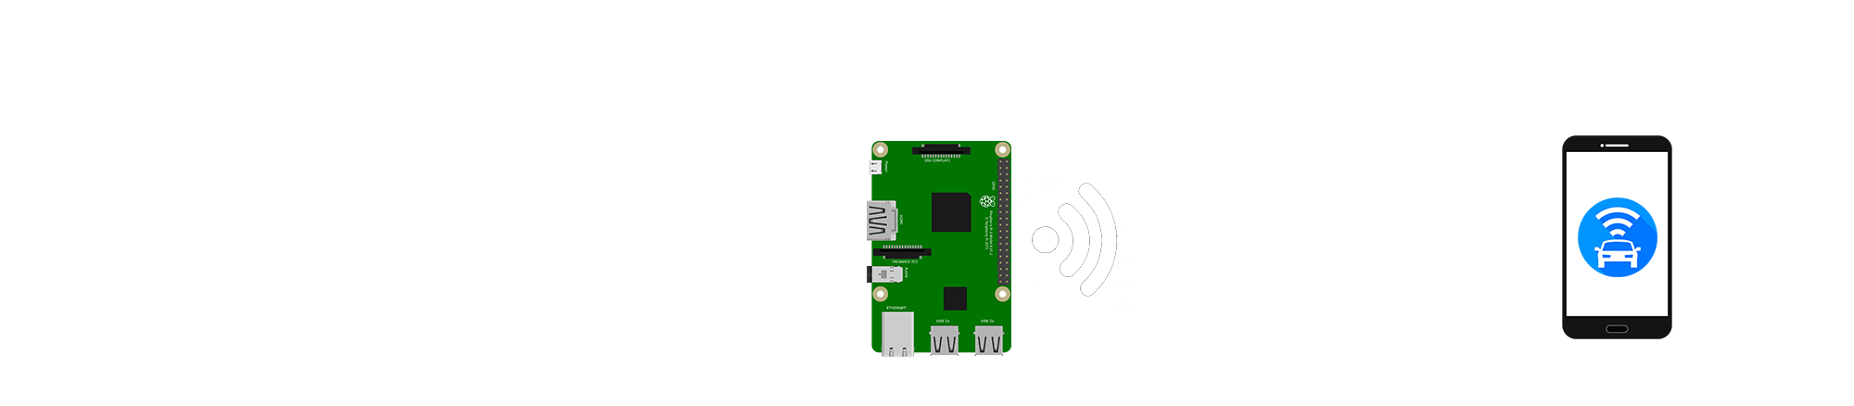
System Overview
The system can be broken down into 3 major parts:
The Android App
The Raspberry Pi and Vehicle
Communication between the Raspberry Pi and Android App
Adrian worked primarily on the Android App Development
Nicholas focused on the Raspberry Pi development
Riley focused on Bluetooth communication as well as the GPS
Notes:
<<I feel like the descriptions in the images are pretty good so I’m just going to copy them here>>
First: The vehicle generates CAN messages during normal operation, which record statistics.
Second: CAN messages are sent from OBD-2 port to Smart AVL Device
Third: Smart AVL converts CAN messages into serialized objects and stores them locally.
Fourth: Serialized objects are wirelessly transmitted to remote user.
Fifth: CAN messages are then deserialized and present to user in a legible format.

Slide 9
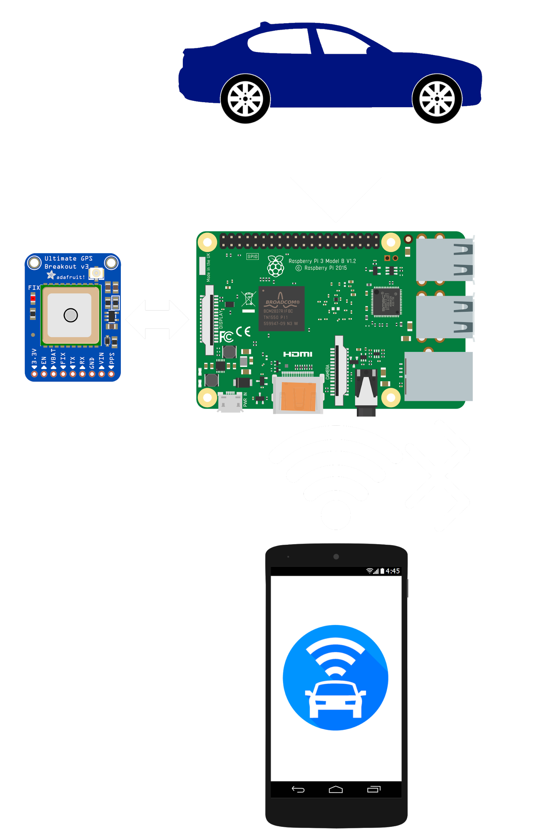
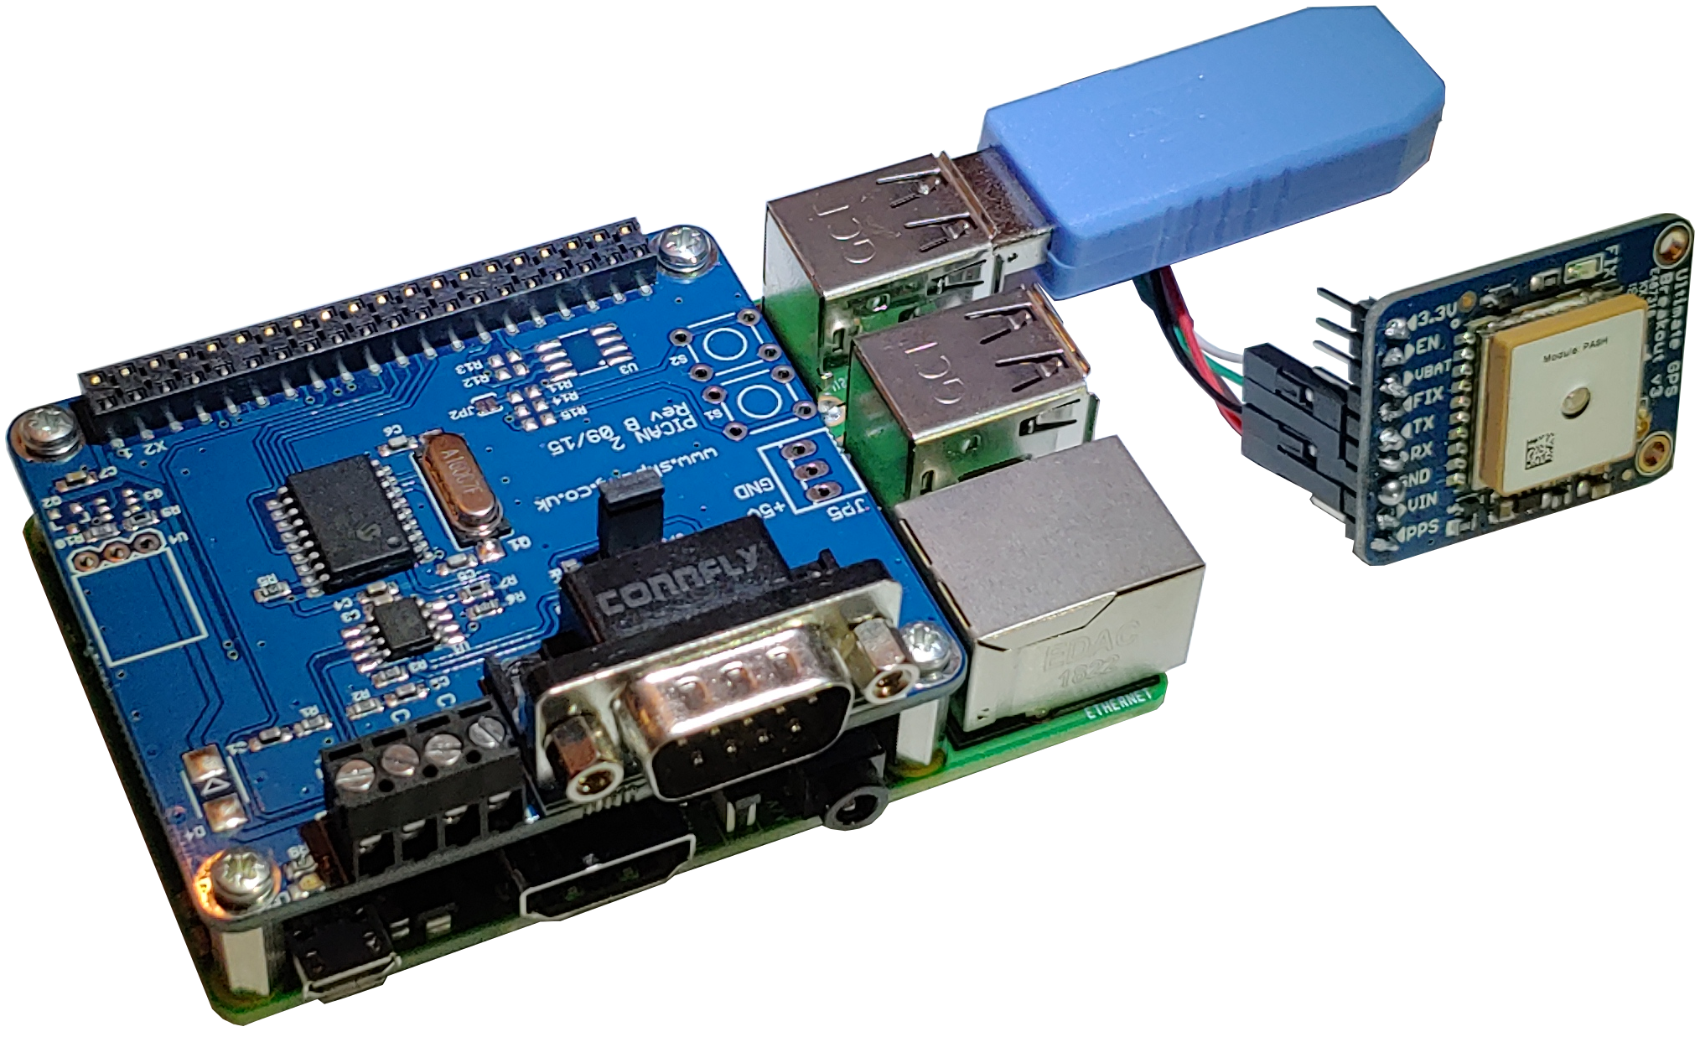
Raspberry Pi - Hardware
Components Used on the Raspberry Pi 3B+
PiCAN 2 CAN interface for Raspberry Pi
OBD-2 to DB-9 Connection Cable
16GB MicroSD Card
Adafruit Breakout GPS
USB-to-TTL Cable
Notes:
As mentioned previously, our system is designed around the Raspberry Pi instead of the Altera DE1 board. The biggest advantage of using the Raspberry Pi is the open source libraries that have already been built for it as well as the wide range of peripheral parts that have been designed specifically for the Raspberry Pi.
To help assist in reading the CAN messages from the vehicle, the PiCAN 2 CAN interface is used. This allows the messages to easily be read from the GPIO pins instead of having to manually configure the pins ourselves. To connect the vehicle and the PiCAN interface together, a OBD-2 to DB-9 cable is used to connect the two.
The SD card used is to store the Raspbian operating system in addition to any local files or scripts that need to be run during execution.
To the side is a picture of what the system looks like with the PiCAN connected to the Raspberry Pi

Slide 10
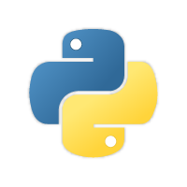
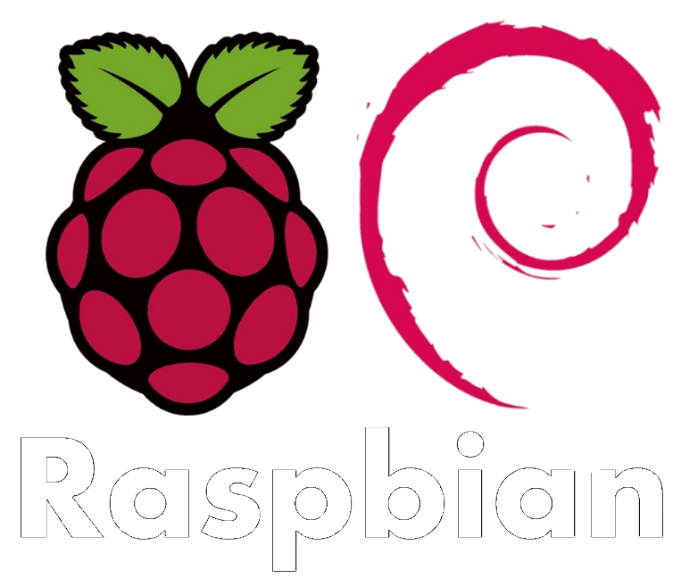
Raspberry Pi - Software
Operating System: Raspbian
Language Used: Python 3
Python CAN library
Raspberry Pi bluetooth library
Adafruit CircuitPython library
Notes:
Raspbian is a Debian based operating system built by the engineers at Raspberry Pi specifically for their products. Debian’s kernel is Linux which boasts a wide-range of open source libraries available to use to help build the project. Raspbian includes support for python which is the language that will used to program the Raspberry Pi. One library that we use in our design is the “python-CAN” library. This is used in conjunction with the PiCAN interface to send requests to the vehicle and then read back the data received.
This data would then be collected and assembled into a JSON string to be transmitted over bluetooth to the Android app.

Slide 11
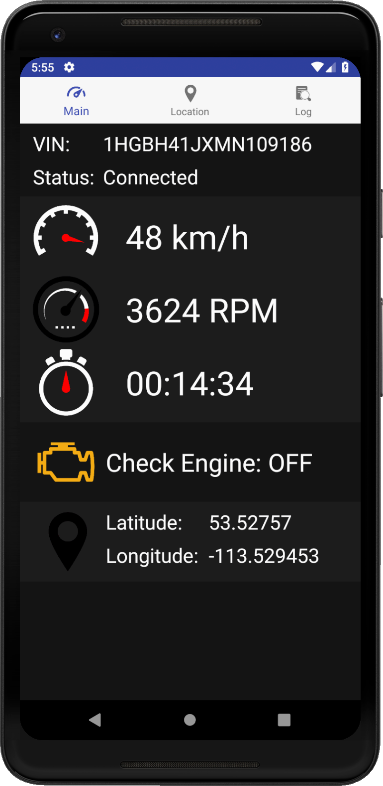
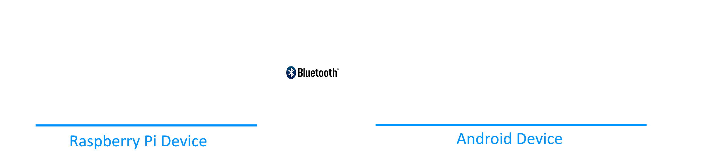
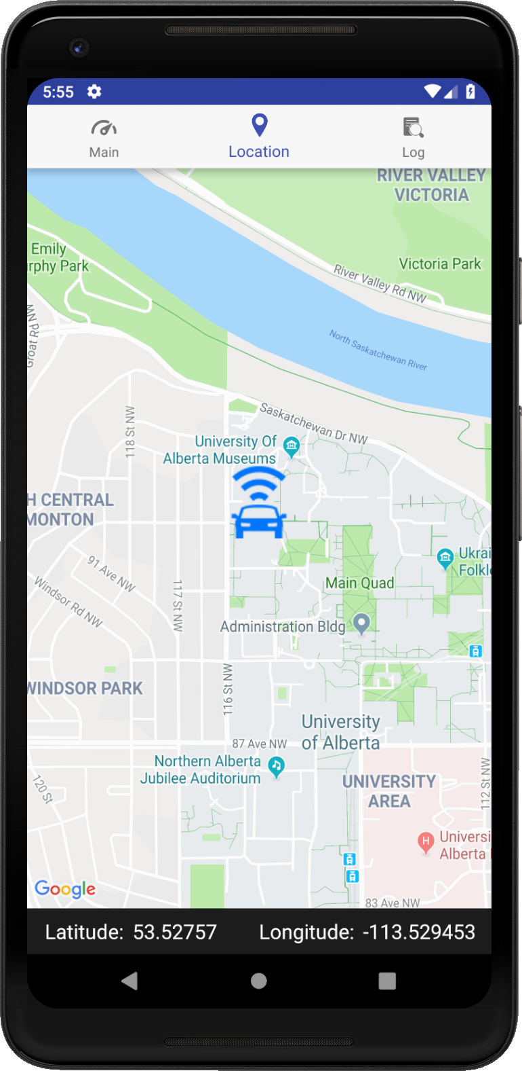

Android App
Smart AVL
User-friendly, minimal and intuitive user interface
Understandable real-time vehicle diagnostics, location and operating information
Live vehicle data is received by the device over Bluetooth in the form of serialized JSON objects, which is then translated into human-understandable format
A Google Maps app activity displays the current vehicle location determined by the GPS attached to the Raspberry Pi device onboard the vehicle
Notes:
The other component of our project is the mobile companion app running on a compatible Android device. The primary goal of the app is to provide a user-friendly, intuitive interface to display understandable real-time vehicle information, including current location and operating information. This information is received over Bluetooth by the Android device in the form of serialized JSON objects. These objects are then converted into Java class objects, which can then be handled and displayed by the app. The vehicle position data is displayed in a Google Maps activity. This position is determined by the Adafruit GPS chip in the Smart AVL device onboard the vehicle.

Slide 12
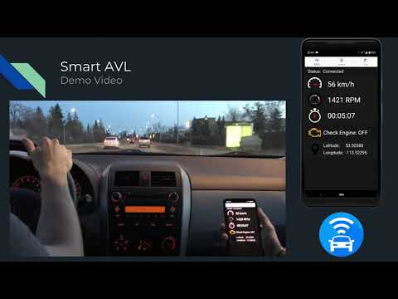
Smart AVL Demo Video

Slide 13
Future Expansion & Iterations
The system has room for additional features to be extended beyond the scope of this project:
Switch remote communication to use cellular data instead of Bluetooth
Not included in this project scope due to limited budget
Have data sent to web server for tracking of entire fleet in real-time
Add ability for Raspberry Pi device to be powered over the vehicle’s OBD-II port
Future testing and improvement of device operation under harsh conditions
Improve Bluetooth pairing process to be more consumer-friendly
Additional app features:
Data history tracking
Operational statistics plotting
Route/location history
Intelligent data analysis and insights
Notes:
Due to limited time and budget, there are several features which could not be included in the scope of this project. These features could be added or expanded upon in future iterations of the project or companion app.
Primarily, the interface for remote communication with the app could be switched from using Bluetooth to cellular data. This would allow a remote user to be nearly anywhere in the world. At a cost of over $200 and increased project complexity, this functionality was too expensive to implement in North America within our limited project budget. A hardware feature that could be added is to power the Raspberry Pi device over the vehicle’s OBD port instead of through a standard USB charger. Testing could be continued to ensure device is capable of operating under sufficiently harsh conditions.
In the prototype, the Bluetooth pairing process is not very user-friendly. This process could be made more convenient through software additions and an added pairing button on the Raspberry Pi device. Future iterations of the companion app could include features such as stats tracking and plotting, route history tracking, and intelligent data analysis and insights. To really drive the ‘smart’ into Smart AVL.

Slide 14
Questions?

